Slide 1

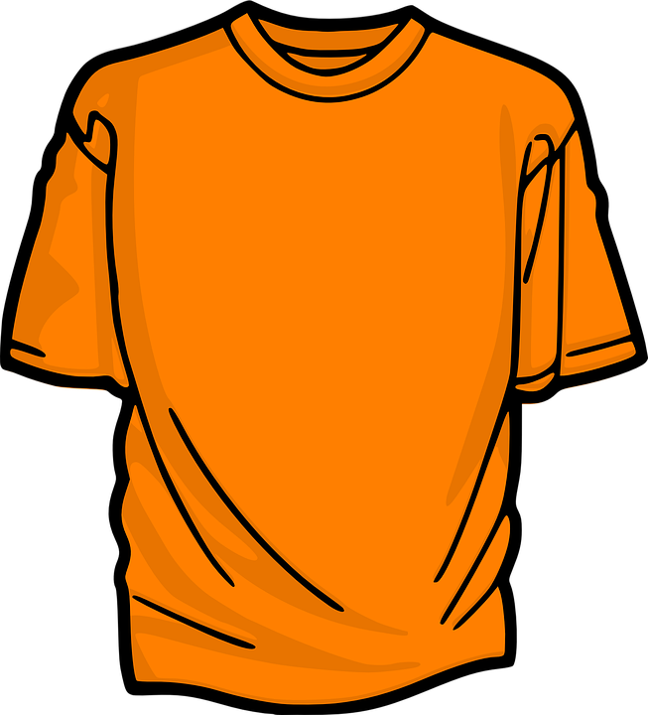

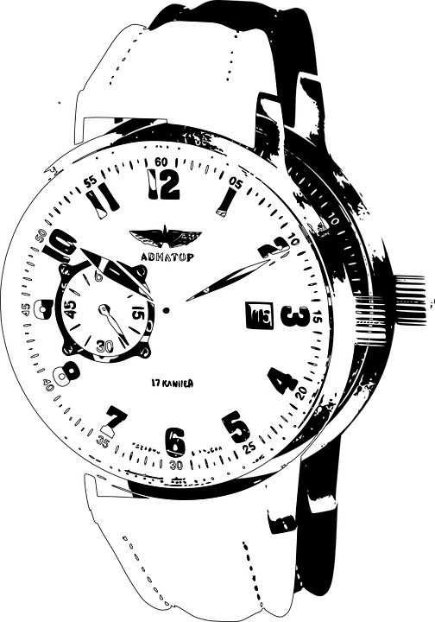
Image Classification
&
Product Recommendation
Syed | Divya | Sairaj

Slide 2

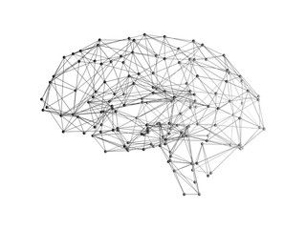




Agenda
1. Objectives
2.Data acquisition & understanding
3.Modeling
4. Results
5.Future Work
6.Conclusion

Slide 3
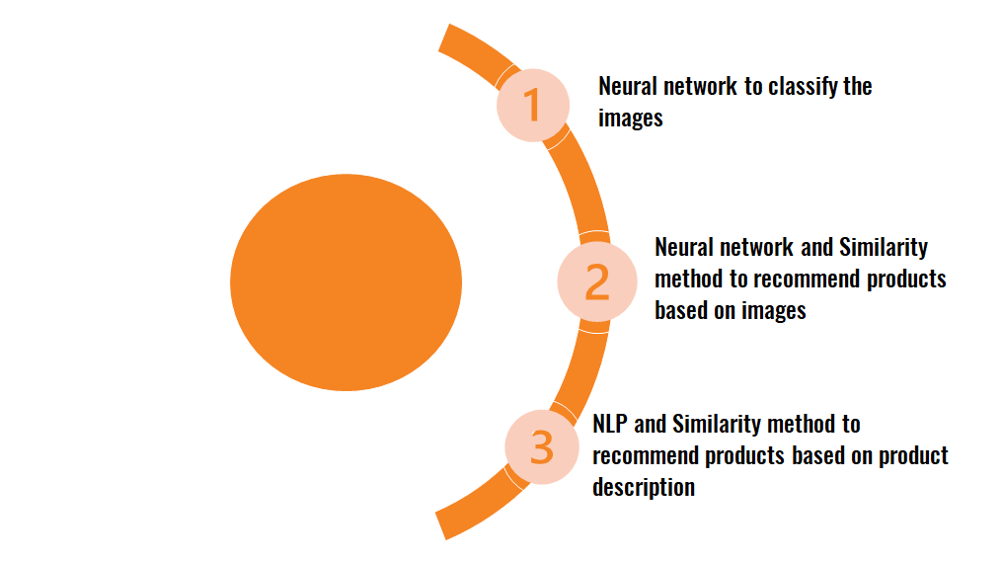

Objective
Build a smart engine for online shopping that takes an image as an input, classifies the image and recommend similar products from the inventory

Slide 4



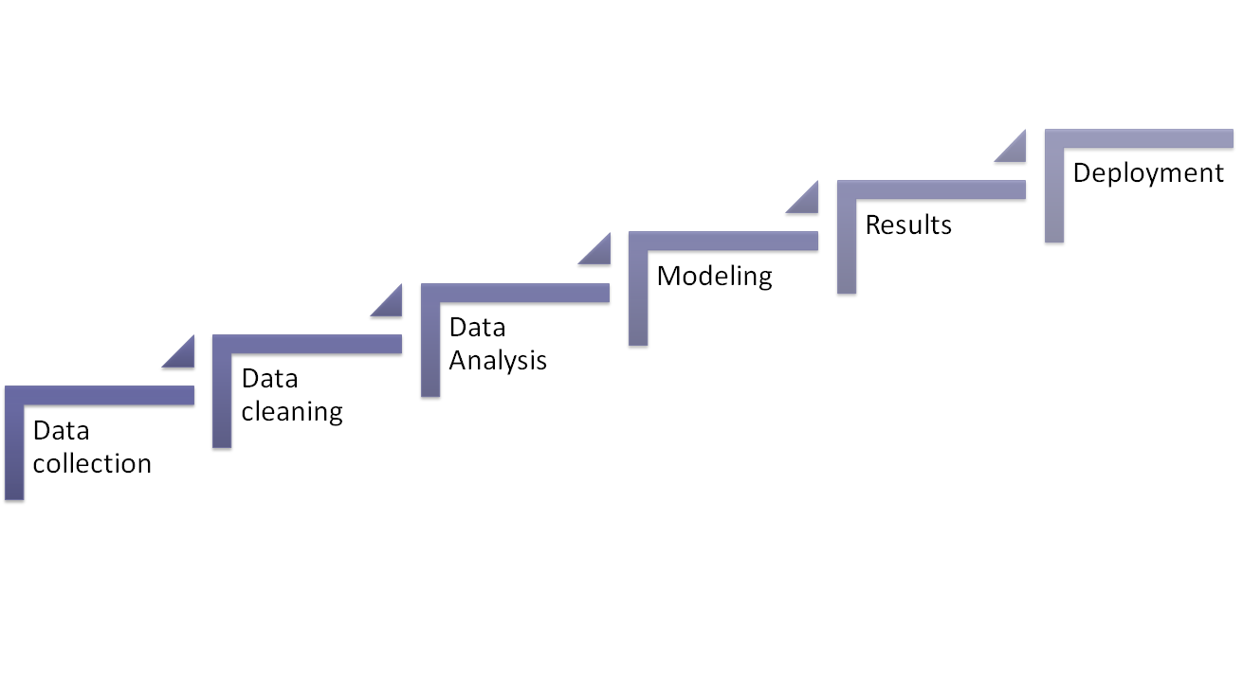



End to end Data Project

Slide 5
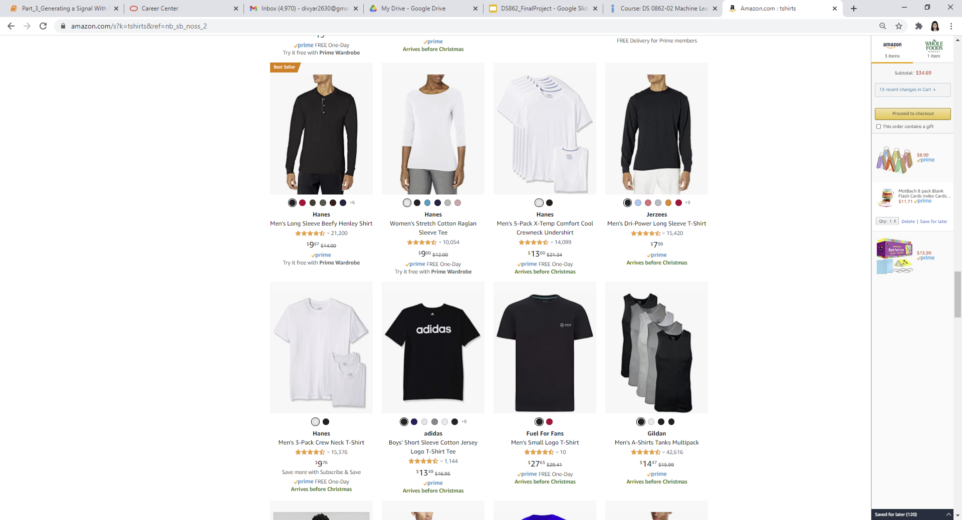




Web Scraping
Ratings and Reviews
Brand name
product title
Price

Slide 6
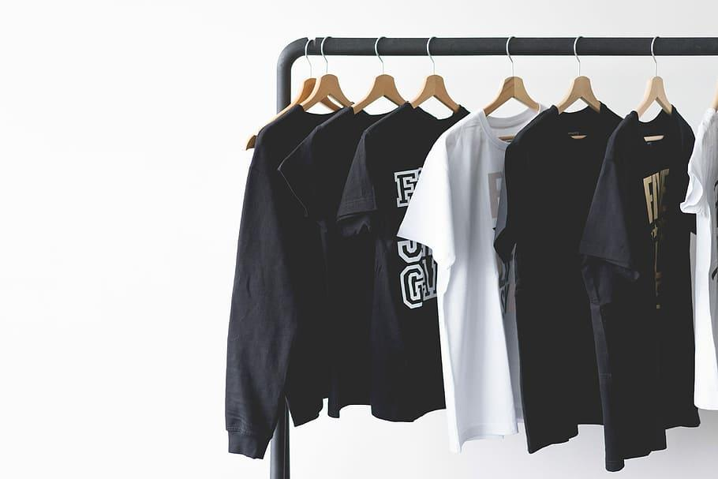


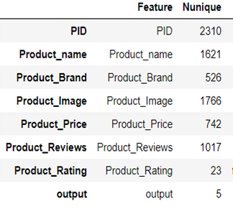

Data Collection
Data Cleaning
Data Scraped
Product Title
Product Brand
Price
Number of reviews
Rating
In excel
Removed ads and errors from scraping.
Added a PID
Reduced to 2310
Product Category/Search Terms
Scraping Information
Hats
Shoes
Shirts
Bags
Watches
10 pages for each category
Total results scraped -2800

Slide 7
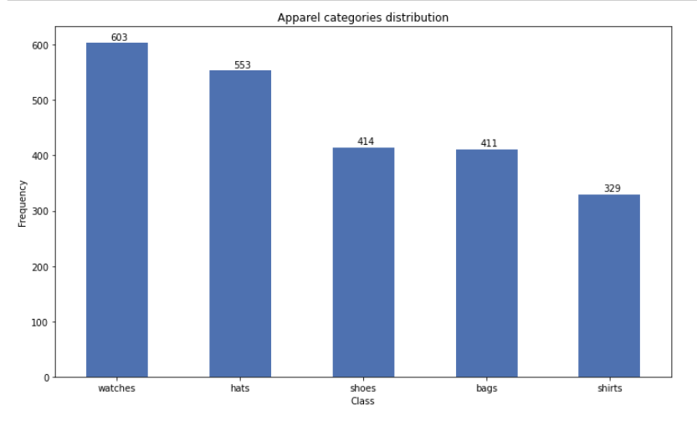
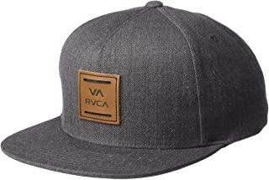
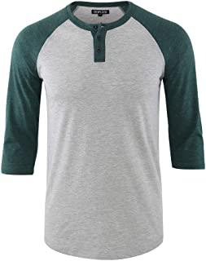
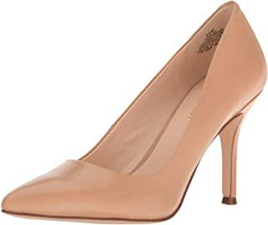
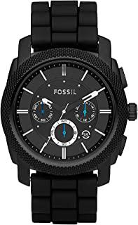
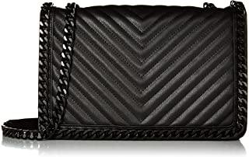
Product Category

Slide 8
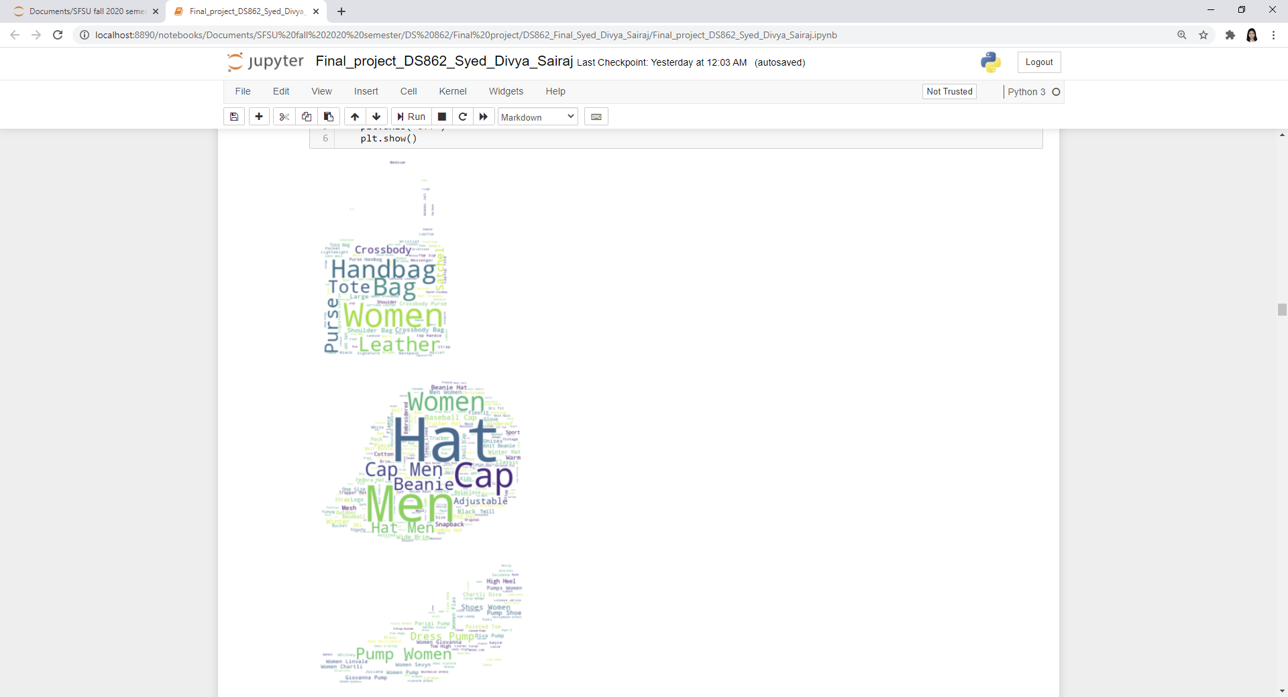
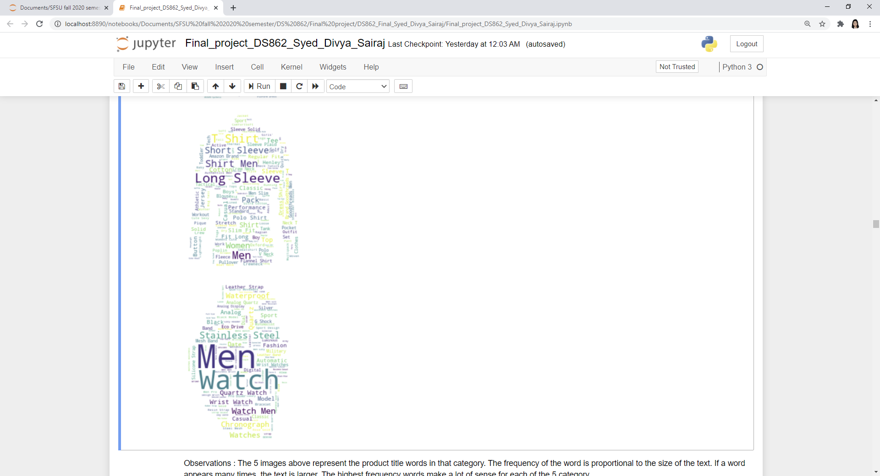
Product Title - Word Cloud
Shirts
Watch
Shoes
Handbags
Cap

Slide 9
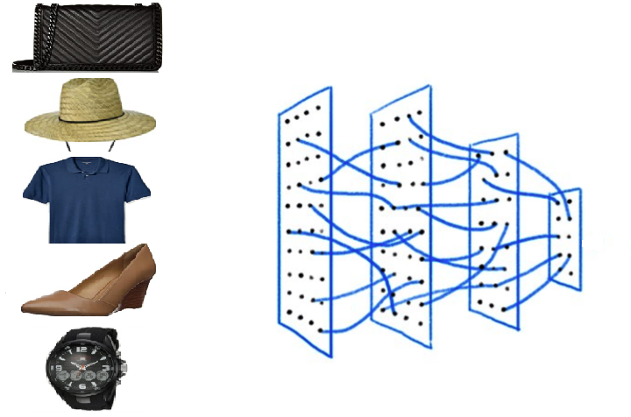
Image Classification
Objective: To identify the correct category of product
Output ?

Slide 10

Image Classification
Process:
Convert the image links from csv and store them into arrays
Train/test split and normalization of pixels between 0 and 1
Model Compilation and
Accuracy measurement
Pick random images from the test data and identify the class of each image
Partial deployment

Slide 11
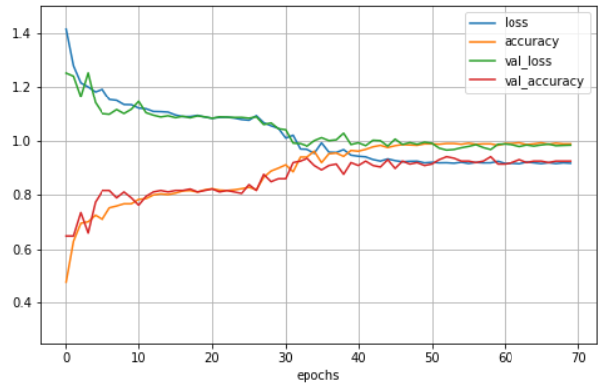
Image Classification
Training/Validation loss and accuracy of the model
Training Hyperparameters:
Training size: 40%
Epoch: 70
Learning rate: 0.001
Optimizer: SGD
Act Function: ReLu
Loss Function: Categorical cross entropy
Dropout: 15%
Regularizer: L1(1e-06)
Results:
Training accuracy: 92.40%
Testing accuracy: 90.76%

Slide 12
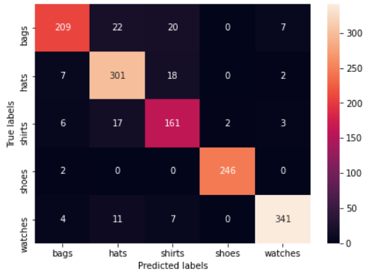
Image Classification
Classification Matrix
Precision:
Bags - 0.92
Hats - 0.86
Shirts - 0.78
Shoes - 0.99
Watches - 0.97
Recall:
Bags - 0.81
Hats - 0.92
Shirts - 0.85
Shoes - 0.99
Watches - 0.94

Slide 13
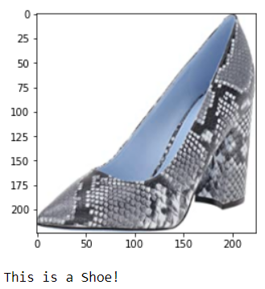
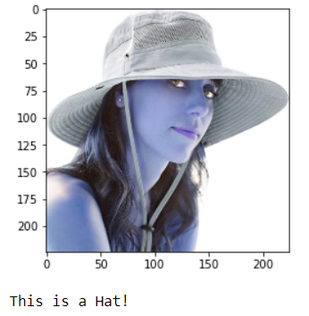
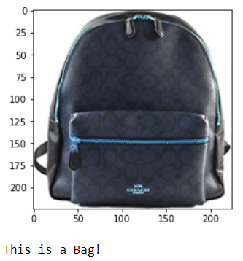
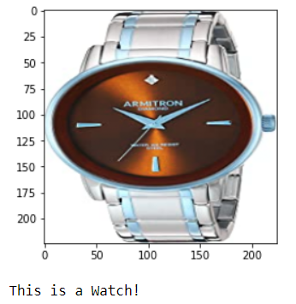
Image Classification - Results
Pick random images from the test data
Identify it’s correct label
Print the image and the class to which it belongs

Slide 14
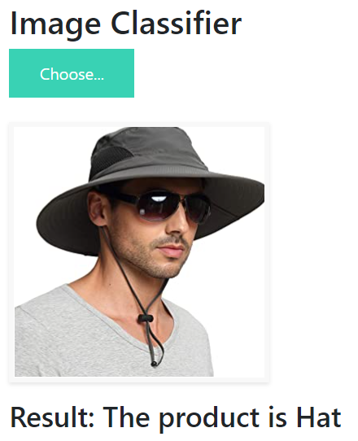
Image Classification
Partial deployment -
http://127.0.0.1:5000/#

Slide 15
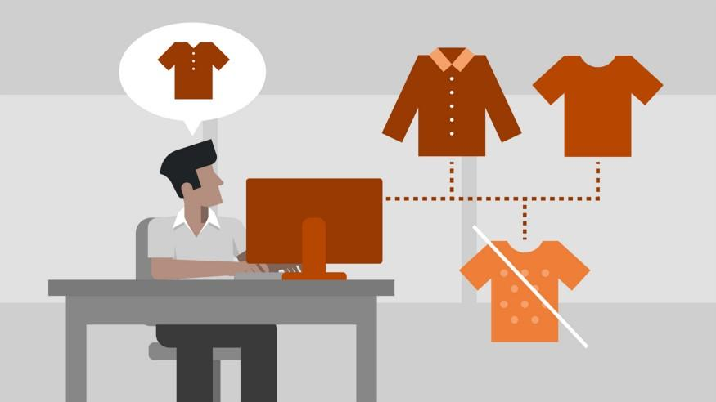
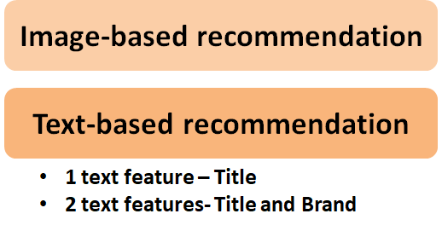
Recommendation Engine
Notes:
The second part of the project deals with recommending the most suitable products to users based on the current selection and choice of the product. Our model relies on the fact that multiple features can be extracted from images and text and used for similarity computation.

Slide 16
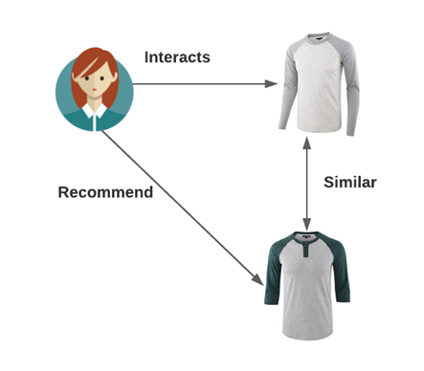
Content-based Filtering
What is “Similarity”?
Computed by item attributes
Items with similar features are recommended
Notes:
The recommendation engine we build in this project is a content based method. In a content based method, we look at the product features to recommend other similar products based on product attributes. The reason why we went ahead with content based filtering method is that we only have product features, if we had user information we could have explore collaborative filtering
Similarity is computed by item attributes. It couild be similarity f text by words, or the same brand or similar rating or image features.

Slide 17
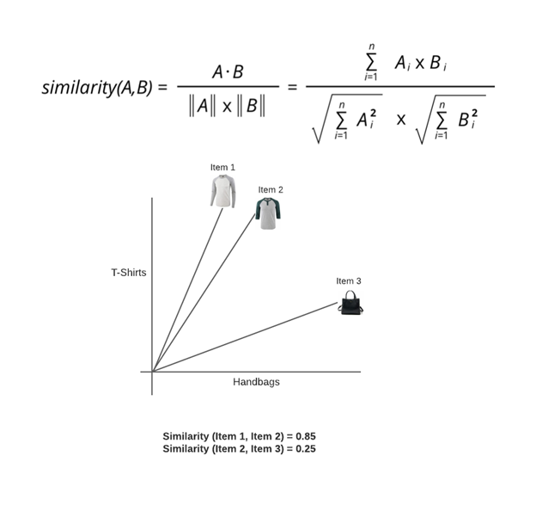
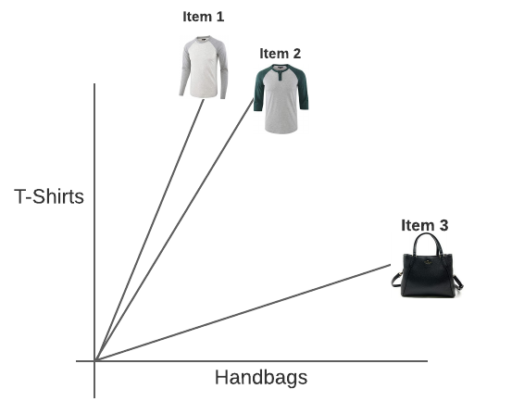
Cosine Similarity
Similarity (Item 1, Item 2) = 0.85
Similarity (Item 2, Item 3) = 0.25

Slide 18
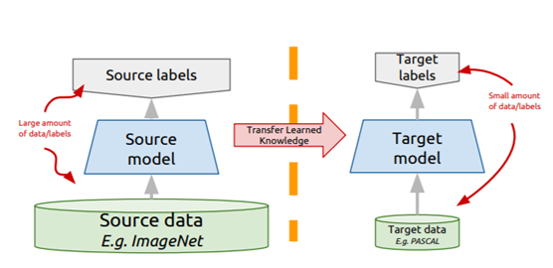
Image-based product recommendation
Transfer Learning
Take a network trained on a different domain for a different source task
Adapt it for your domain and your target task

Slide 19
Image-based product recommendation
Objective: To recommend N products based on the images
Extract image features using VGG16 (pre-trained model)
Remove the final layer in neural network
Compute cosine similarity of any two image features
Print N recommendations based on high score

Slide 20
Title based product recommendation
Objective: To recommend N products based on the product title
Convert the product title to BoW
Compute cosine similarity of any two image features
Print N recommendations based on high score

Slide 21
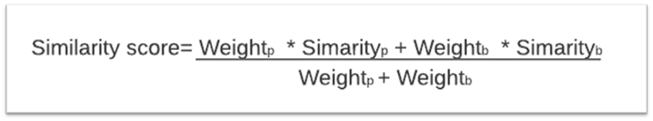
Title+Brand based recommendation
Objective: To recommend N products based on the product title and product brand
Similar to title based recommendation
Cosine similarity is calculated based on the weighted average method
Notes:
The recommendation engine we build in this project is a content based method. In a content based method, we look at the product features to recommend other similar products based on product attributes. The reason why we went ahead with content based filtering method is that we only have product features, if we had user information we could have explore collaborative filtering
Similarity is computed by item attributes. It couild be similarity f text by words, or the same brand or similar rating or image features.

Slide 22
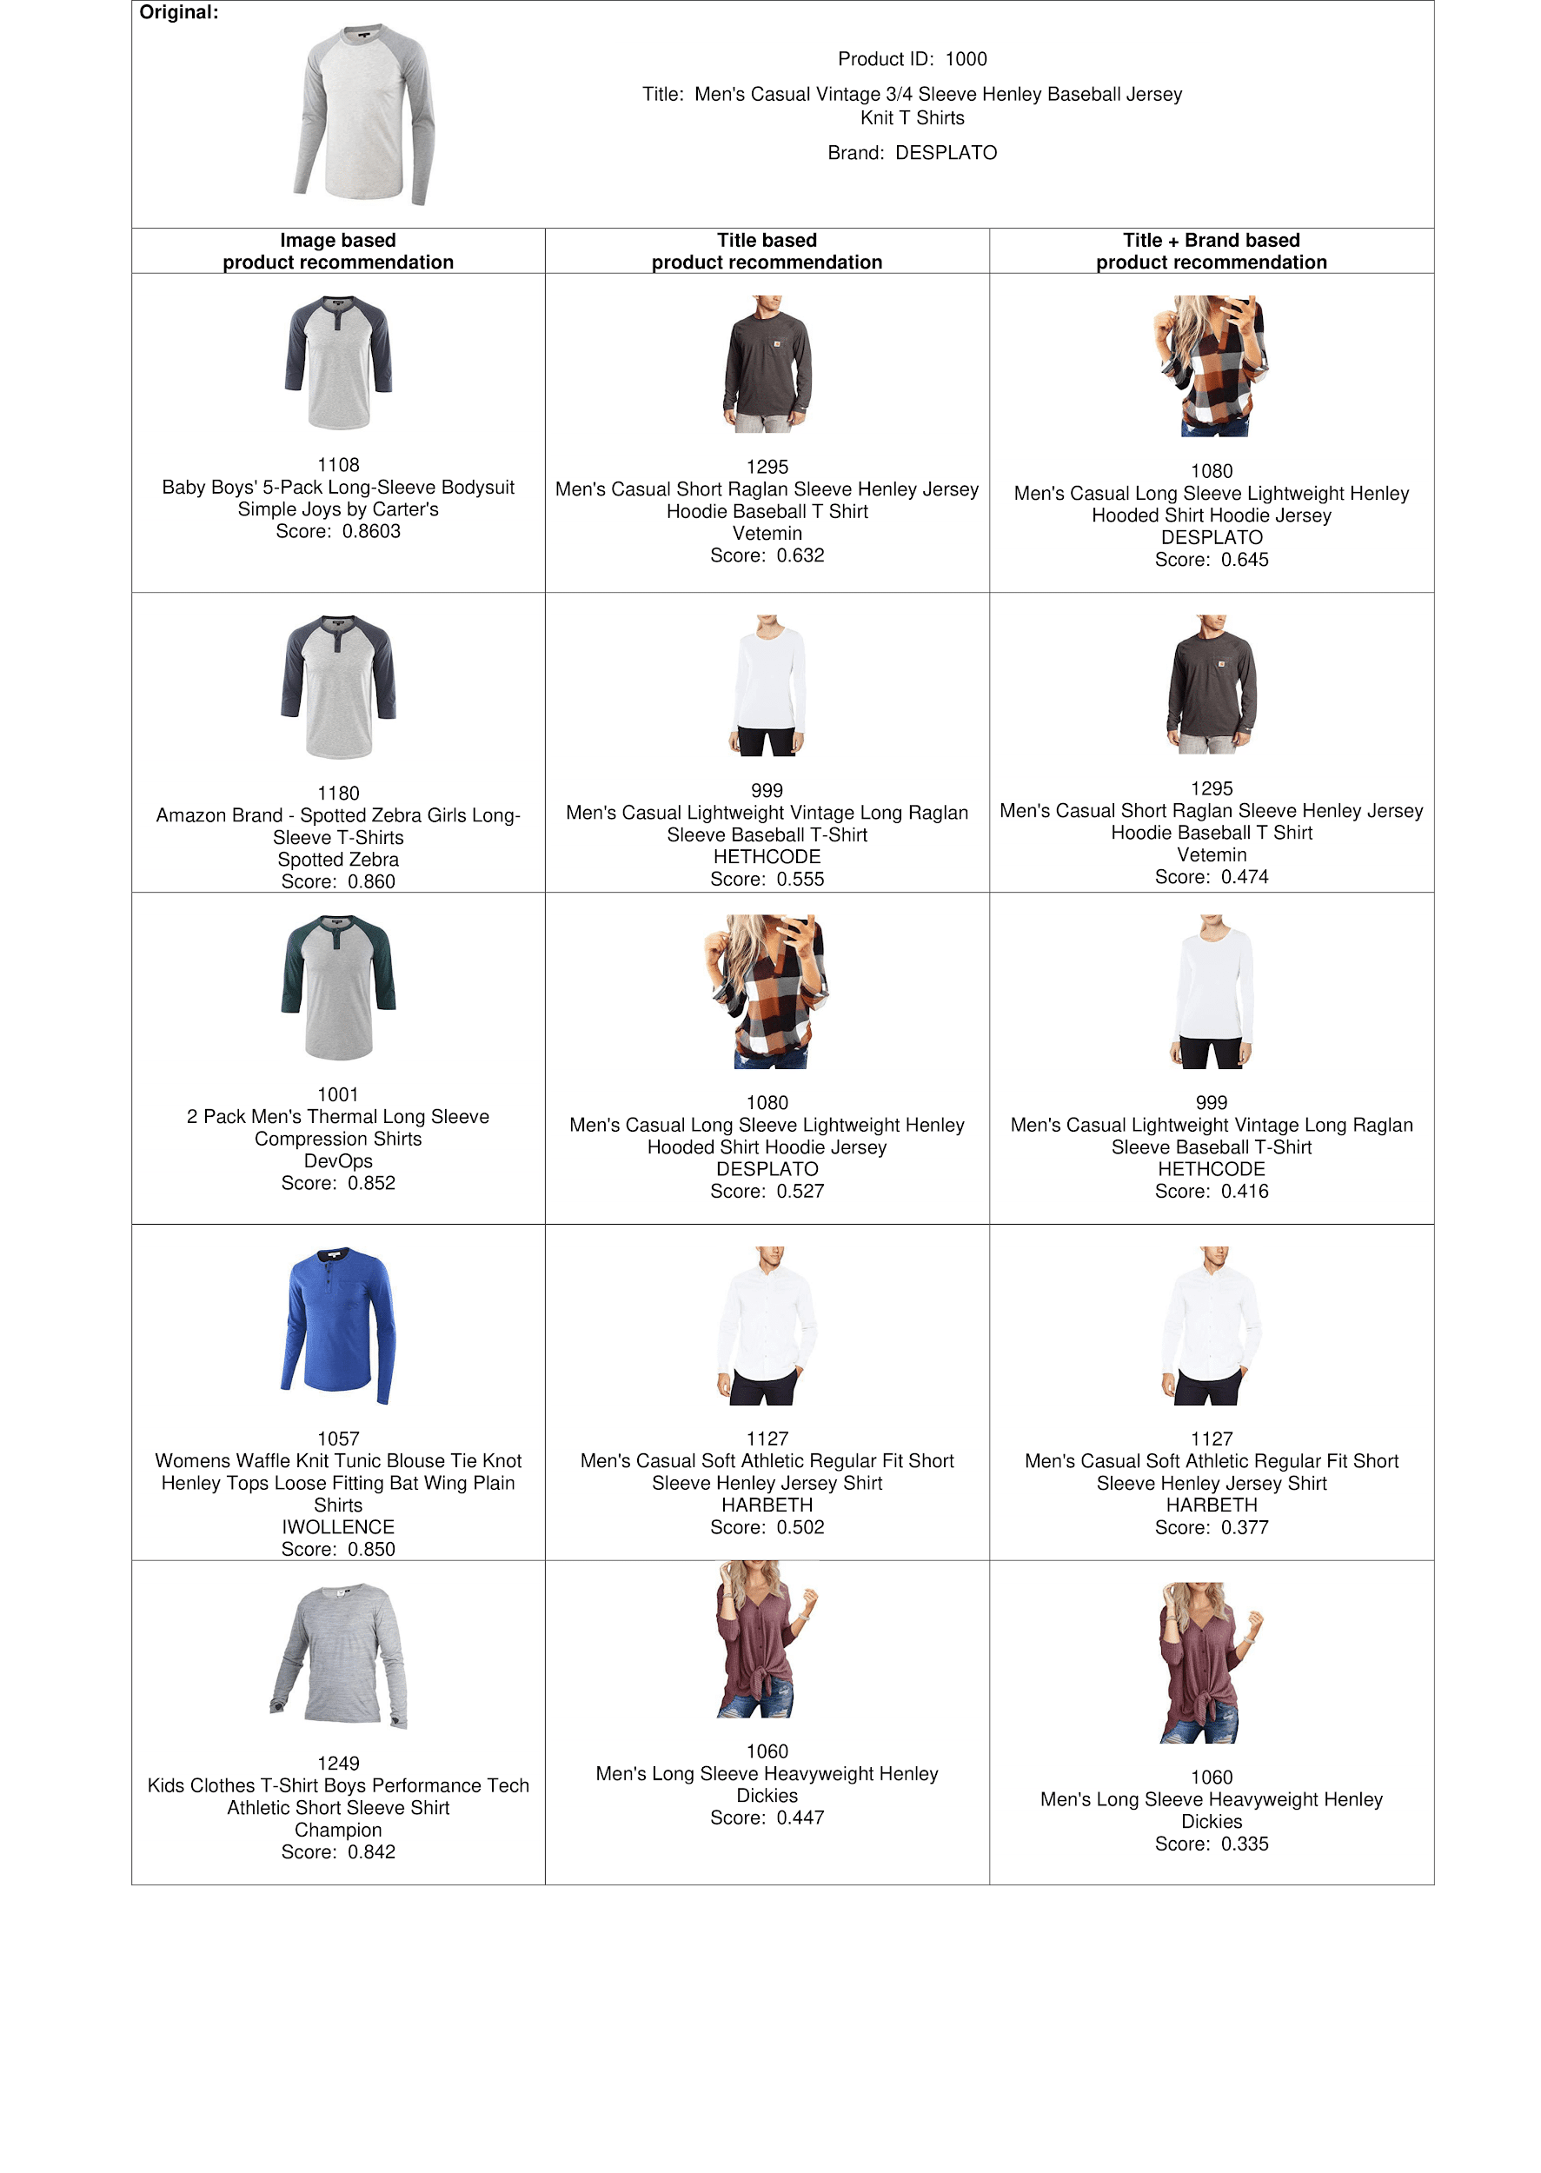
SAMPLE RESULT

Slide 23
Notes:
Observations :
The products recommended for Product ID: 1000 (Picture : 9) gives good results for the image-based recommendation method with the highest similarity score of 0.86. The text based methods produce scores of around 0.63.
The products recommended for Product ID: 200 (Picture : 10) gives good results for the title based recommendation method with the highest similarity score of 0.92.
In the third picture, the score is highest for image based recommedation system compared to the text based recommendation system.
In all the three pictures, the text based methods have many common results, whereas the image based is quite different.
Apart from the above three results, several results were printed and compared. Based on the products in our database, image based recommendation system seems to give the best results, but with the information here we can not give conclusive results.

Slide 24
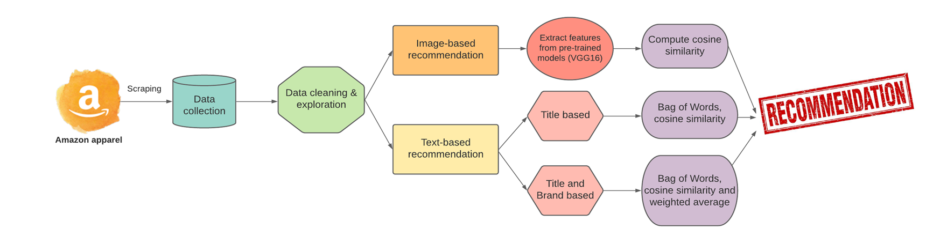
Approach
Notes:
The recommendation engine we build in this project is a content based method. In a content based method, we look at the product features to recommend other similar products based on product attributes. The reason why we went ahead with content based filtering method is that we only have product features, if we had user information we could have explore collaborative filtering
Similarity is computed by item attributes. It couild be similarity f text by words, or the same brand or similar rating or image features.

Slide 25

Future Work
1
2
3
Build a recommendation engine that incorporates both the image based and text based methods.
Collaborative filtering (Model Based in specific)
Create a web-app to deploy the model- Classification & Recommendation
Notes:
The recommendation engine we build in this project is a content based method. In a content based method, we look at the product features to recommend other similar products based on product attributes. The reason why we went ahead with content based filtering method is that we only have product features, if we had user information we could have explore collaborative filtering
Similarity is computed by item attributes. It couild be similarity f text by words, or the same brand or similar rating or image features.

Slide 26
Conclusion
Evaluate the three recommendation methods through experimentation. Through A/B/n testing, we can make data driven decisions based on the click through rates or customer purchases from users in the test.
Notes:
We didn’t evaluate our recommendation engines. A good way to evaluate the recommender systems is through experimentation. One such experimentaion method is A/B/n testing, where users can be put in a test group and we can set metrics such as click through rate or purchase . So if a user in the test group clicks or purchases the item that has been recommended, then it adds to the metric and we canfinally decide the best recommendation engine

Slide 27
Thank You
Any Questions?

